Slide 1

Microsoft Word - 2007

Slide 2
What is MS Word?
Microsoft Word is word processing software. It is developed by Microsoft and is part of Microsoft Office Suite. It enables we to create, edit and save professional documents like letters and reports.
Note:
Microsoft word was released in 1983 as Multi-Tool Word.
Its first version was based on the framework of Bravo which was world's first graphical writing program.
Microsoft renamed Multi Tool Word to Microsoft Word, and then in October 1983, Microsoft released its first version for the IBM PC.

Slide 3
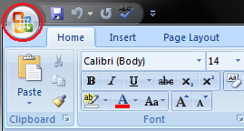
MS Word Button -
Microsoft Office Button is located on the top left corner of the window. It is a new user interface feature that replaced the traditional "File" menu.
When we click the button it offers a list of commands to perform different tasks which are New, Open, Save, Save As, Print, Prepare, Send, Publish and Close.

Slide 4
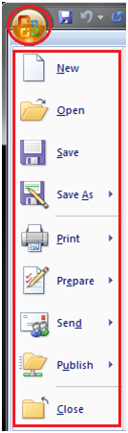
MS Word Button -
New: This command enables we create a new file, i.e. Word document.
Open: This command allows we to open an existing file on the computer.
Save: This command is used to save a file after completing the work. we can also save the changes made to the currently open file.
Save As: This command helps we save a new file with a desired file name to a desired location on the hard drive.
Print: This command is used to print a hard copy of the currently open document.

Slide 5
MS Word Button -
Prepare: This command allows we to prepare the document for distribution, i.e. we can view and edit the document properties and inspect the hidden metadata.
Send: This command allows we share the document with other users, i.e. we can send a document through e-mail or by posting to a blog.
Publish: This command allows we distribute the document to other people, i.e. we can create a blog with the content of the document.
Close: This command is used to close the currently open file.

Slide 6
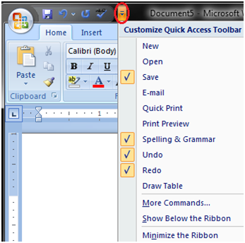

Quick Access Toolbar -
When we click the drop-down arrow next to toolbar it offers more commands. With a left click we can add any of these commands to Quick Access Toolbar. we can also remove the commands added to the tool bar.
Quick Access Toolbar lies next to the Microsoft Office Button. It is a customizable toolbar that comes with a set of independent commands. It gives we quick access to commonly used commands such as Save, Undo, Redo, etc.

Slide 7
Title Bar -
It lies next to the Quick Access Toolbar. It displays the title of the currently open document or application. It is present on almost all windows displayed on our computer.
So, if there are several windows across the screen, we can identify each window by looking at the title bar.
In many graphical user interfaces, we can also move a window by dragging the title bar.

Slide 8
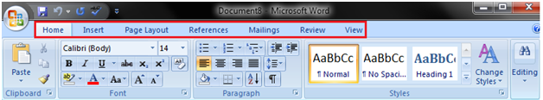
Ribbon and Tabs -
The Ribbon is a user interface element which was introduced by Microsoft in Microsoft Office 2007.
It is located below the Quick Access Toolbar and the Title Bar.
It comprises seven tabs; Home, Insert, Page layout, References, Mailing, Review and View.
Each tab has specific groups of related commands. It gives us quick access to the commonly used commands that we need to complete a task.

Slide 9
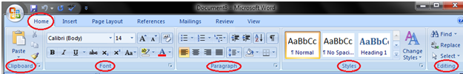
HOME Tab -
The Home tab is the default tab in Microsoft Word.
It has five groups of related commands; Clipboard, Font, Paragraph, Styles and Editing.
It helps us change document settings like font size, adding bullets, adjusting styles and many other common features.
It also helps us to return to the home section of the document.

Slide 10
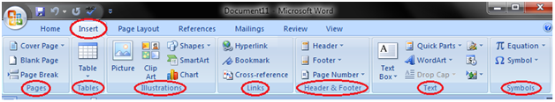
INSERT Tab -
Insert Tab is the second tab in the Ribbon.
As the name suggests, it is used to insert or add extra features in our document.
It is commonly used to add tables, pictures, clip art, shapes, page number, etc.
The Insert tab has seven groups of related commands; Pages, Tables, Illustrations, Links, Header & Footer, Text and Symbols.

Slide 11
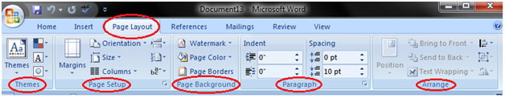
PAGE LAYOUT Tab -
It is the third tab in the Ribbon.
This tab allows us to control the look and feel of your document, i.e. we can change the page size, margins, line spacing, indentation, documentation orientation, etc.
The Page Layout tab has five groups of related commands; Themes, Page Setup, Page Background, Paragraph and Arrange.

Slide 12
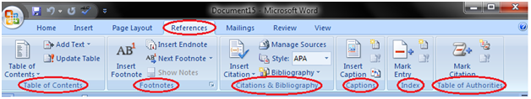
References Tab -
It is the fourth tab in the Ribbon.
It allows us to enter document sources, citations, bibliography commands, etc.
It also offers commands to create a table of contents, an index, table of contents and table of authorities.
The References tab has six groups of related commands; Table of Contents, Footnotes, Citations & Bibliography, Captions, Index and Table of Authorities.

Slide 13
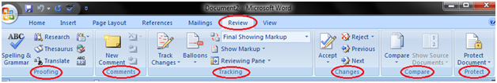
Mailings Tab -
It is the fifth tab in the ribbon.
It is the least-often used tab of all the tabs available in the Ribbon.
It allows you merge emails, writing and inserting different fields, preview results and convert a file into a PDF format.
The Mailings tab has five groups of related commands; Create, Start Mail Merge, Write & Insert Fields, Preview Results and Finish.

Slide 14
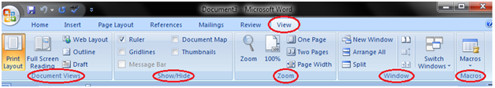
View Tab -
The View tab is located next to the Review tab.
This tab allows you to switch between Single Page and Two Page views.
It also enables you to control various layout tools like boundaries, guides, rulers. Its primary purpose is to offers you different ways to view your document.
The View tab has five groups of related commands; Document Views, Show/Hide, Zoom, Window and Macros.

Slide 15
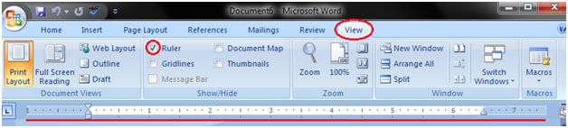
Ruler -
The Ruler is located below the Ribbon around the edge of the document.
It is used to change the format of the document, i.e. it helps you align the text, tables, graphics and other elements of your document.
It uses inches or centimeters etc. as the measurements unit and gives you an idea about the size of the document.
File -> Options -> Advanced -> Display Section -> Show measurement in units of

Slide 16
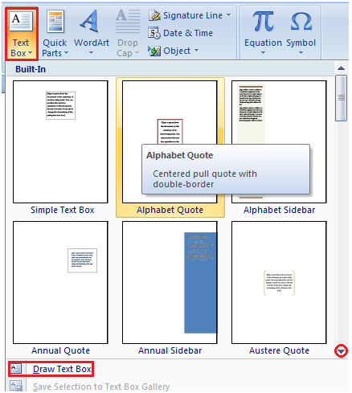
How to Insert Text in MS Word -
The basic steps to insert text or to create a new document in Word are listed below –
Go to the start menu and look for Microsoft Word icon
Click the icon to open the Microsoft Word
You will see a blinking cursor or insertion point in the text area below the ribbon
Now, as you start typing, the words will appear on the screen in the text area
To change the location of insertion point press spacebar, Enter or Tab keys

Slide 17
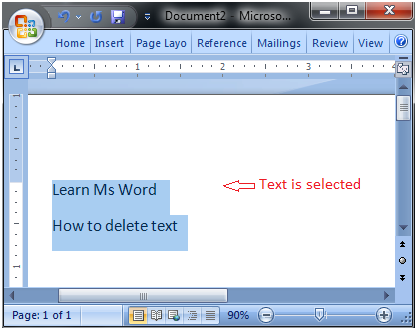
How to Delete Text in MS Word -
We can easily delete the text in Word including characters, paragraphs or all of the content of our document.
Word offers us different methods to delete the text; some of the commonly used methods are given below -
Place the cursor next to the text then press Backspace key
Place the cursor to the left of the text then press Delete key
Select the text and press the Backspace or Delete key
Select the text and type over it the new text

Slide 18
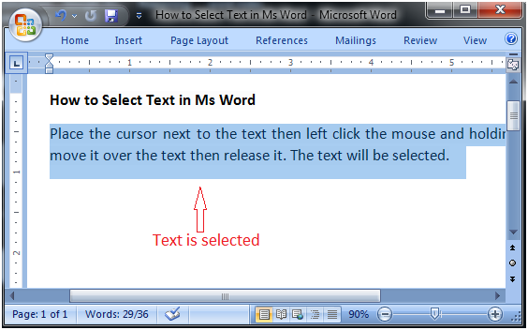
How to Select Text in MS Word -
Place the cursor next to the text then left click the mouse and holding it down move it over the text then release it. The text will be selected.
Some shortcuts for selecting text are -
To select a single word double click within the word
To select the entire paragraph triple click within the paragraph
To select entire document, in Home tab, in Editing group click Select then choose Select All option or press CTRL+A
Shift + Arrows; hold down the shift key then press the arrow key, the word will select the text in the direction of the arrow key. There are three arrow keys, so we can select the text in three different directions.

Slide 19
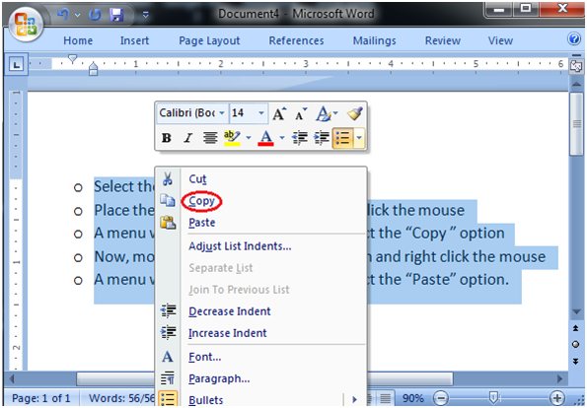
How to Copy and Paste Text in MS Word -
Word offers different methods to copy and paste text. Some of the popular methods are given below -
Method 1 -
Select the text you want to copy
Select the Home tab and click the Copy command
Place the cursor where you want to paste the text
Click the Paste command in Home tab
Method 2 -
Select the text
Place the cursor over the text and right click the mouse
A menu will appear; with a left click select the "Copy" option
Now, move the cursor to a desired location and right click the mouse
A menu will appear; with a left click select the 'Paste" option.

Slide 20
How to Save the Document in MS Word -
When you create a document it is important to save the document so that it can be viewed or reused later. The basic steps to save a document are listed below -
Click the Microsoft Office Button
A list of different commands appears
Click the 'Save As' command
it displays 'Save As' Dialogue Box
Save the document to desired location with a desired name
We can also choose 'Save' command from the list to save the document to its current location with same title. If you are saving a fresh document it displays 'Save As' dialogue box.
The shortcut method to save a document is to press "Ctrl + S" keys. It opens the 'Save As' dialogue box where you can name you document and save it to a desired location.

Slide 21
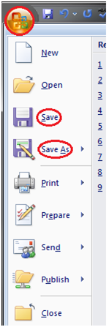
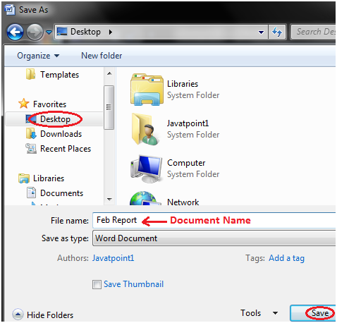

Slide 22
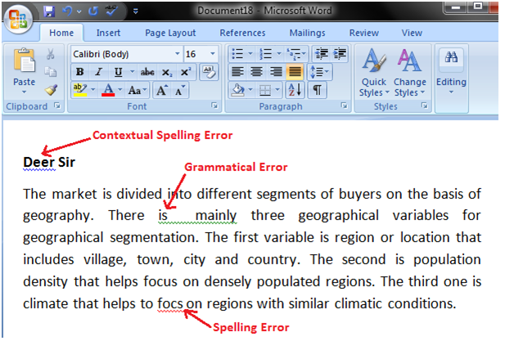
How to Correct Errors in MS Word -
When you type text in a document, by default the Word informs you if there is any contextual, spelling or grammatical error. Word informs you in different ways for different errors -
If there is any contextual error in the document, it will underline the text with blue line.
If there is any spelling error in the document, it will underline the text with red line.
If there is any grammar error in the document, it will underline the text with green line.

Slide 23
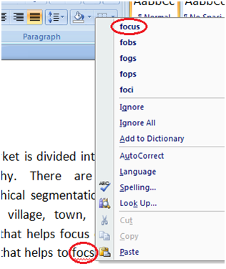
How to Correct Errors in MS Word -
Steps to correct errors -
Place the cursor over the text that you want to correct
Right click the mouse
A list of suggestions appears
Choose the correct word with a left click

Slide 24
How to Correct Errors in MS Word -
Steps to correct errors -
Place the cursor over the text that you want to correct
Right click the mouse
A list of suggestions appears
Choose the correct word with a left click

Slide 25

How to Check Word Count in MS Word -
When we start typing, the Word automatically counts the number of words and number of pages and displays the information on the status bar.
If the word count is not available on the status bar, we can right click the status bar and select the Word Count option from the menu.
Basic steps to check the word count are listed below –
Open the document
Look at left bottom corner of the document
We will see the total world count and the number of pages

Slide 26
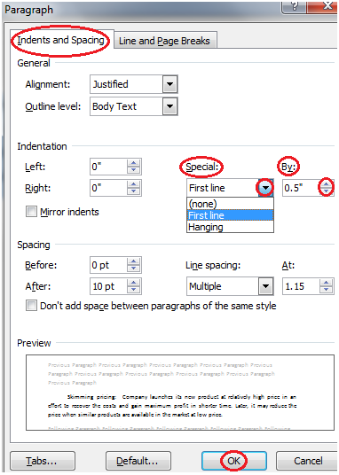
How to Create First Line Indent in MS Word -
We can create indent within the paragraph by following these steps -
Select the paragraph or place the cursor anywhere within the paragraph
Select the Home tab
Locate the Paragraph group and click the arrow at right bottom corner
'Paragraph' dialog box appears
In 'Indents and Spacing' section click the drop down arrow in 'Special' field
Select the 'First Line' option
Enter desired indent in 'By' field and click Ok

Slide 27
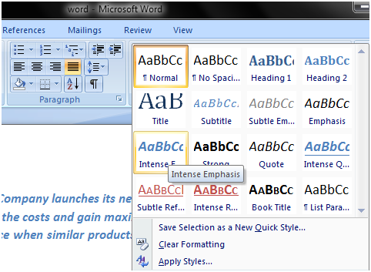
How to Apply Style in MS Word -
We can create professional and presentable documents in MS Word by applying different styles.
The basic steps to apply a style in a document are listed below -
Select the text to which we want to apply the style
Select the Home tab
In Styles group we will see different styles
Note:
To view more styles click the drop-down arrow
It displays style menu
Select the desired style with a left-click

Slide 28
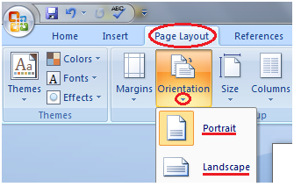
How to Change Page Orientation in MS Word -
Page Orientation refers to the direction in which a document is displayed.
It is of two types –
portrait (vertical)
landscape (horizontal)
The default orientation is portrait; it can be changed to landscape by following these steps -
Select the Page Layout tab
Locate the Page Setup group
In Page Setup group click the Orientation command
It displays two options, Portrait and Landscape
Select the desired page orientation

Slide 29
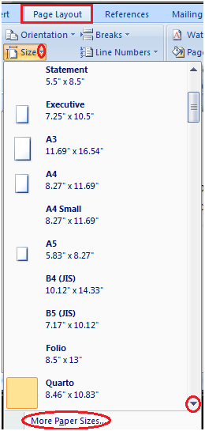
How to Change Page Size in MS Word -
The default paper size in Word is 8.5 x 11 inches
which easily fits in printers.
This size is not fixed.
The steps to change the paper size are given below -
Click the Page Layout tab
In Page Setup group click the Size command
Paper size menu will appear
With a left click select the desired paper size
To customize page size click the 'More Paper Sizes' option

Slide 30
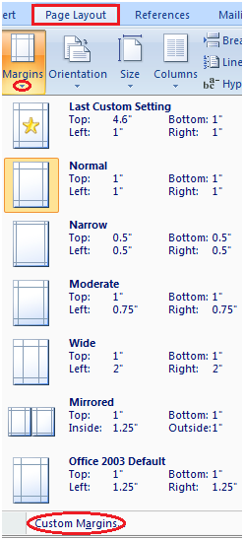
How to Change Page Margins in MS Word -
The margin is the space between the text and border of a document.
By default, it is a one-inch space.
Depending on your needs, it can be changed
by following the below-listed steps;
Select the Page Layout tab
In Page Setup group click the Margins command
A list of Margins appears
Select the desired Margin with a left click

Slide 31
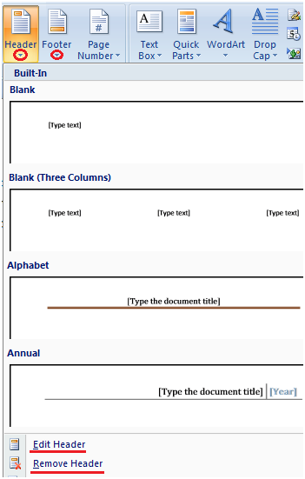
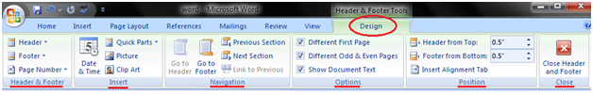
How to Insert Header and Footer in MS Word -
Header and Footer allow you to add additional information like dates, file names, page numbers at the top or bottom of your document.
The basic steps to set up a header and footer are given below -
Select the Insert tab
Locate the Header & Footer group
It shows Header and Footer commands
As required click either Header or Footer command
It displays a list of built in Header or Footer options
Select the desired option

Slide 32
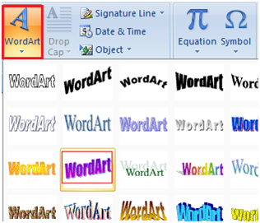
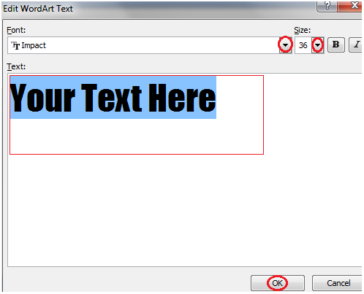
How to Insert WordArt -
Word Art is designed to allow you make your text more attractive; you can format your text to make it look like a picture and enhance its appearance in different ways.
The steps to insert WordArt are given below -
Place the cursor where you want to insert WordArt
Select the Insert tab
In Text group click the 'WordArt' button
WordArt menu appears
Select the desired WordArt style
'Edit WordArt Text' dialog box appears
Type the text in text area and click OK

Slide 33
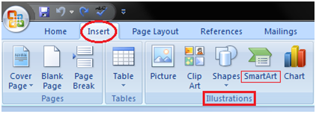
How to Insert Smart Art Graphics -
You can insert Smart Art Graphics in your document to effectively communicate your message.
You can insert a process flow, a relationship or an organization hierarchy.
The steps to insert smart art graphics are given below -
Place the cursor in the document where you want to insert graphics
Select the Insert tab
In Illustrations group select the 'Smart Art' command
On left side, a dialog box appears with list of categories
In the center you will see the illustrations available in a category
Select the desired illustration and click Ok

Slide 34
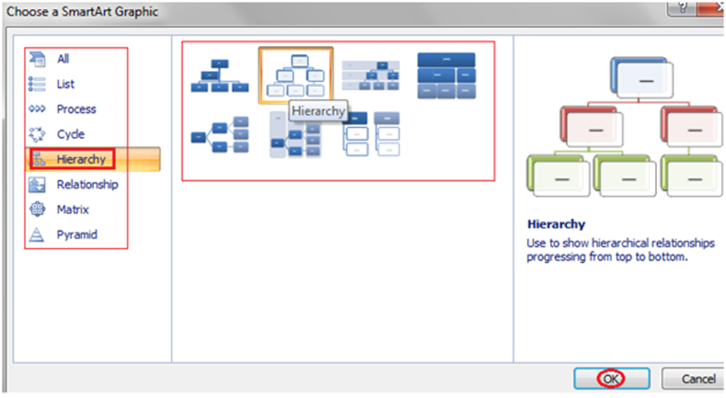

Slide 35
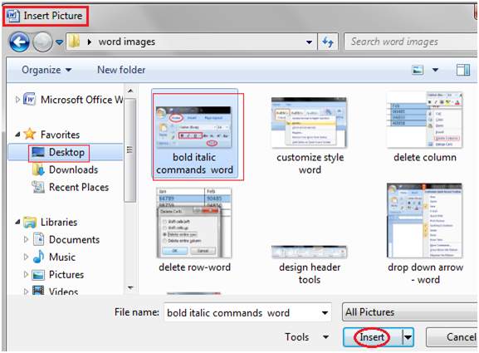
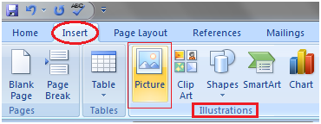
How to Insert Picture in Document -
Pictures make our text more attractive and readable.
You can insert relevant pictures in your text by following these steps -
Place the cursor where you want to insert the picture
Select the Insert tab on Ribbon
In Illustrations group click the Picture command
It displays 'Insert Picture' dialog box
Select the desired image
Click Insert to insert the picture

Slide 36
Assignment - 1
Create a document in Word on a topic of your choice.
Format the document with various fonts (minimum 12, maximum 15) and margins (minimum 2, maximum 4).
The document should include -
a) A bulleted or numbered list
b) A table containing name, address, basic pay, department as column heading
c) A picture of lion using clip art gallery
d) An example of word art
e) A header with student name & date
f) A footer with pagination

Slide 37
Assignment - 2
Create a document with the text given below and save it as First.Doc
A Read only Memory is a memory unit that performs the read operation only, it does not have a write capability. This implies that binary information stored in a ROM is made permanent during the hardware production of the unit and cannot be altered by writing different words into it. Whereas a RAM is a general-purpose device whose contents can be altered during the computational process, a ROM is restricted to reading words that are permanently stored with in the unit. The binary information to be stored, specified by the designer, is then embedded in the unit to form the required interconnection pattern.
Do the following a) Count the occurrences of the word “ROM” in the above document. b) Replace ROM with Read Only Memory in the entire document c) Underline the text Read Only Memory d) Make an auto correct entry for ROM and it should be replaced by Read Only Memory

Slide 38
Assignment – 3 & 4
Use first.doc to perform the following operations –
Make the first line of document bold
Make the second line italic
Underline the third line
Align the fourth line to center
Make the font color of first line as red
Change the font style of fifth line to Arial
Change the second line to 18 points
Insert the date & time at the start of document
Use the document earlier saved and perform the page setting as follows –
Top Margin 1.3”
Bottom margin 1.4”
Left margin 1.30”
Right margin 1.30”
Header 0.7”
Footer 0.7”
Paper size executive
Orientation landscape

Slide 39
Assignment - 5
Insert a table. The table should have 5 columns. The following report has to be created in the table.
(a) Heading should have a font size of 18, color should be blue and font should be bold.
(b) The data should have a font size of 12, color should be Red and font should be italic
(c) Insert a new row between 3 & 4 and type the data and reorder the sr. no column.
Sr. No. | Name | Basic Pay | Designation | Department
1 | A | 10000/- | MD | Marketing
2 | B | 12000/- | AD | Sales
3 | C | 8000/- | Manager | Sales
4 | D | 9000/- | Sr. Manager | HR

Slide 40
Assignment - 6
Below is given a letter and some addresses, this letter is to be sent to all these addresses, so use mail merge option to do so –
Addresses are -
1) Amit Shaw House No. – 424, Sector - 8D, Chandigarh
2) Rohit Tiwari House No. - 444, Sector - 125C, Chandigarh
3) Jyoti Chatterjee House No. - 550, Sector - 16A, Chandigarh
The letter is –
To <<Name>> <<Address>> Dear <<Name>> You are called for an interview on the <<Date>>at 9:00 A.M with your original documents. Yours Sincerely, ABC Limited Mohali

Slide 41
Assignment - 7
Make a template for the bio-data with the following format-
Bio-Data
Name :
Father’s Name :
Date of Birth :
Age :
Address :
Educational Qualification:
Sr. No Qualification Board Percentage

